Slide 1

Visual Studio SQL Projects
https://tinyurl.com/SqlProjCodeCamp
(sample code and slides)
Notes:
Prep:
Open visual studio new proj
Open imported project
Open SSMS
Open Github Runner CLI and github page
Open VS Code showing Github Actions
Open terminal to run Bath publish file
Welcome to this session: An introduction to SQL Projects in Visual Studio. Thank you for attending this session!

Slide 2

Intro
Juan Pablo Tarquino
Software Developer with about 20 years of experience
LinkedIn
https://www.linkedin.com/in/juantarquino
Blog (not updated often ☹ )
https://jptarqu.blogspot.com
Sample repo for this session:
https://tinyurl.com/SqlProjCodeCamp
Notes:
My name is Juan Tarquino, I am software developer with 20 years of experience, mostly .NET and SQL, but I also did some Ruby and Java and even a dialect of Cobol earlier in my career.
Here is my linked in link, if you wish to contact me with questions or comments after the conference, or if you would just like to connect.
The sample GitHub repository for this session is at this link (QR code).
I know is hard to believe but I was not born in this country, so I do have an accent. Please feel free to ask me to repeat or to clarify things if there is something I am not explaining clearly. I will not be offended at all.

Slide 3
Today’s talk
Level: mostly beginner, with some deeper dives
Outline
Why SQL Projects
How to Create SQL Projects
How to Deploy (including CI/CD integration)
How to do Automated Testing
Conference sessions are great! They allow interactions with speakers and other attendees.
Notes:
Todays talk! It is going to be an introduction. We will do some deeper dives every at some points, but it will be mostly geared towards those unfamiliar or those just starting with SQL Projects in Visual Studio. I do assume you are a little bit familiar with Visual Studio and SQL in general.
Outline: we will talk about Why we need VS Sql Projects, what problems it addresses, how to create one, how to do deployments from those projects, and finally, how to perform some level of automated testing on the SQL code. At different points I will be providing some suggestions based on my own experience that may help you in your journey of defining SQL databases in Visual Studio.
I love conferences, they are a great format for learning because you can interact with the speaker and your fellow attendees, and the speaker can tune or change the presenstation midway in order to server better the audience. So if at any point you have any questions or comments, please be sure to ask!

Slide 4
Once upon a time in Pizzas’R’Us™…
Pizzas’R’Us™ is a small but profitable company, trying to be as nimble as possible, providing pizza services to restaurants and super-markets.
Notes:
We will start our session with a story abut a pretend company and a a fake dev team. This story will help us frame the problem that VS tries to solve and how to solve it.
Our pretend enterprise is Pizzas’R’Us. A small but profitable company, trying to be as nimble as possible. They provide pizza services to restaurants and super-markets.

Slide 5



Once upon a time in Pizzas’R’Us™…
Alexandria
Junior Dev always seeking the most efficient and safe way to accomplish the business goals
Michael J
Alexandria’s co-worker, also a junior dev, working hard with Alexandria, wearing multiple hats at the company.
David
Alexandria’s and Michael’s boss. A rocker by night, a manager by day.
Notes:
The development team at PizzaRUs is what you would find in many small organizations: a few dev wearing multiple hats and their manager. In the case of our pretend team, we have:
Alexandria: Junior Dev always seeking the most efficient and safe way to accomplish the business goals. Experienced in .net development but have not designed any database since college.
Michael J: Alexandria’s co-worker, also a junior dev, working hard with Alexandria, wearing multiple hats at the company
And finally, David: their manager and aspiring rock star.

Slide 6
The Business Goal
Develop an app to help the Business Units manage and publish the weekly podcasts. The podcasts are mostly interviews with Pizza Chefs all over the world.
The app must maintain state in a database, MS SQL Server is what the company uses because it already paid a hefty license fee for it due to other 3rd party software that uses it.
The data needs to be able to be queried from other tools/apps to help the BU audit and ask questions about how well the podcast is progressing.
Notes:
One day David comes to the team with a new project from the Business Unit: The business unit runs a weekly podcast where they interview Pizza Chefs from all over the world. The business unit needs an application to keep track of the publishing of the episodes in the podcast and any other information related to running the odcasts, such as payments made to guests and requests from Chefs to appear in the podcast.
The app must maintain state, and David tells the team they have to use SQL Server because it is what the company is willing to support at this point. The company’s IT is already familiar with SQL server due to other 3rd party applications that use it. There is simply no bandwithh or money to learn, secure or maintain another database technology.
Another important requirement is that the data must be able to be queried by the BU through their favorite tools such as PowerBI and Excel.

Slide 7
Initial attempts
SSMS
Need source control.
.NET ORM, (e.g.: Entity Framework)
Cannot define views and Stored Procedures in C#, still relies on SQL code.
Migration mechanism to update the actual db does not look right (not declarative, delta operations vs desired state).
Notes:
Like most of us do when we are just starting to learn database development, Alexandria fires up her favorite tool for managing dbs (SSMS), she connects to ther local sqexpress instance and does a right click new db. She starts working on the payments feature of the app, so she creates the sql objects needed for that feature via SSMS.
Michael J asks her if she can share her sql work with him because he needs to test something for the payments feature. Alexandria stops and thinks to herself, how am I going to share this with Michael J, this work is in my local workstation. For the .net part of the app, all she needs to do is push her changes to source control so that Michael can use her changes. Is there something similar for SQL databases?
After some research she finds that EF allows her to do migrations from C# classes defined in her C# project. But she runs into a blocker when she needs to define a SQL View. She realizes that ORMs are designed to be mappers, and not as a tool to design and define a database. Their main goal is to map a relational concept to an object oriented concept, even if they do offer handy tools for pushing changes to databases.
She goes back to research again to find a way to define her database in a way that can be maintained in source control and that will have the same firendlness and SQL features she finds in SSMS sucha s intellisense for SQL code.

Slide 8
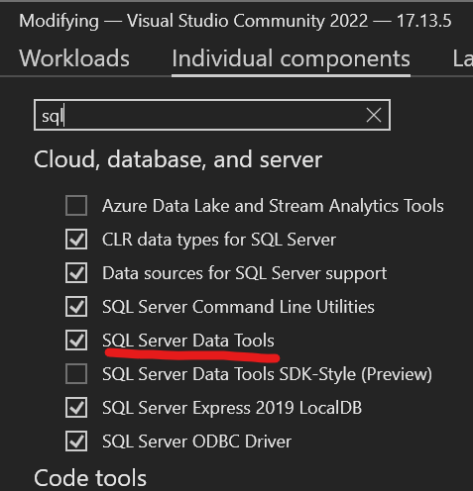
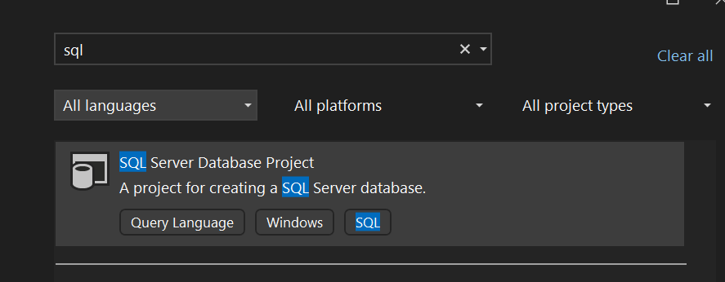
Visual Studio SQL Projects to the rescue
Two types
“Legacy” MSBuild based proj file format
SDK-style proj file (Preview)
Similar to other VS projects
IntelliSense and CoPilot
Find references
Folder organization
Source control
“New Item” menu, examples:
Roles
SQL types
Notes:
Alexandria finds Visual Studio SQL Projects!
To create a new SQL project, she gwork,and searches for the SQL template. If you do not see the template, it is possible that the component is not installed in VS. You can look for “SQL Server Data Tools” in the VS installer.
When she clicks create, she fills in some typical fields that VS asks for such as the location of the folder where to put the project files.
Once created, Alexandria stares at a blank project and wonder if there is a way to re-use the work she already did in her local sql instance. Sure enough, she find that she can right click on the project and then do “import database”. This step is something that Visual Studio will let you do once and only for projects that are blank. The wizard that pops up will ask you for the location of the database that you want to the import your structure from. I do not select the referenced logins nor the security objects and I leave the rest as defaults. You can connect to any SQL Server db you have access to.
The Visual Studio project allows her to create folder so that she can organize the SQL code. The folders are just for organization, the do not translate to any special structure in SQL. However, you can add schemas to your sql project and then assign sql objects to those schemas. E.G. in this logical folder I have my “api” schema and I assign the SP in there to that schema by virtue of putting “api.” in the name of the procedure.
Because it is a file based project, now she can push the definition to source control, just like any other VS project. If using git, I strongly suggest using the Visual Studio gitignore template fro GitHub so that no VS artifact gets into source control (example in repo).
Like other VS projects Alexandria can do right click new item and she sees a plethora of items that she can add to her project. IMHO this is a great way for those not familiar with the power of sql server to get familiar with some of the tings that SQL server supports.
One example I want to concentrate on is “roles”. I like to create the roles in my sql project and specify the permissions of that role in the project so that they are in source control. That way the repository is the source of truth of the available permissions. I strongly suggest avoiding giving DBO access to the entities that run your application. Take the time to define roles and be specific on what those roles can select, execute, delete, etc. See example in repo.
Another example of a feature that many devs might not be familiar with is SQL Types. SQL types are basically aliases for SQL type definitions. They help sql code to be more readable and maintainable. For example, instead of using varchar(100) everywhere you need a LastName column in a table or a last name parameter in a stored procedure, you can just define a LastName type that derives from varchar(100) and use that type across all your SQL objects. See the examples here.
You can also define database properties in the sql project, things like Read Committed and File Stream. That way when you deploy the project, the options are also set in the db that is receiving the deployment (we will talk about deployment later).

Slide 9
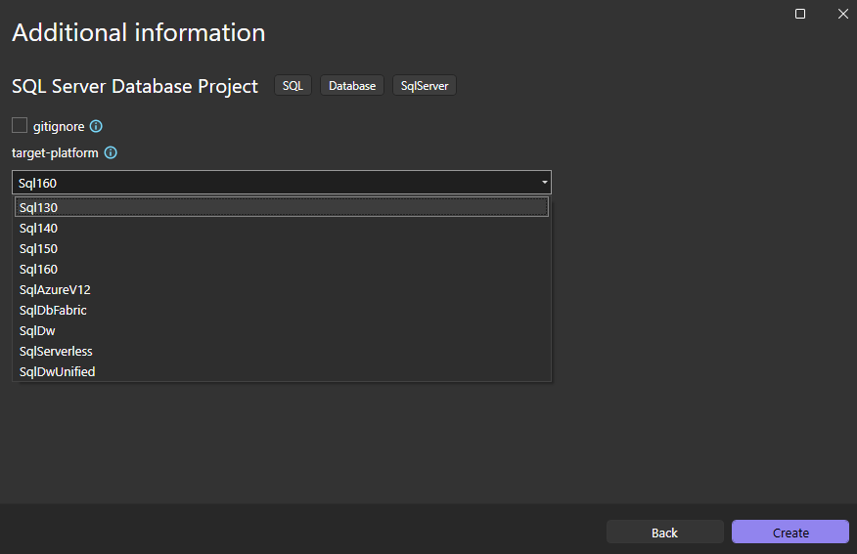
SDK style projects
dotnet tool install -g microsoft.sqlpackage
dotnet new install microsoft.build.sql.templates
Installs template for cli and also for Visual Studio
Notes:
Alexandria finds Visual Studio SQL Projects!
To create a new SQL project, she gwork,and searches for the SQL template. If you do not see the template, it is possible that the component is not installed in VS. You can look for “SQL Server Data Tools” in the VS installer.
When she clicks create, she fills in some typical fields that VS asks for such as the location of the folder where to put the project files.
Once created, Alexandria stares at a blank project and wonder if there is a way to re-use the work she already did in her local sql instance. Sure enough, she find that she can right click on the project and then do “import database”. This step is something that Visual Studio will let you do once and only for projects that are blank. The wizard that pops up will ask you for the location of the database that you want to the import your structure from. I do not select the referenced logins nor the security objects and I leave the rest as defaults. You can connect to any SQL Server db you have access to.
The Visual Studio project allows her to create folder so that she can organize the SQL code. The folders are just for organization, the do not translate to any special structure in SQL. However, you can add schemas to your sql project and then assign sql objects to those schemas. E.G. in this logical folder I have my “api” schema and I assign the SP in there to that schema by virtue of putting “api.” in the name of the procedure.
Because it is a file based project, now she can push the definition to source control, just like any other VS project. If using git, I strongly suggest using the Visual Studio gitignore template fro GitHub so that no VS artifact gets into source control (example in repo).
Like other VS projects Alexandria can do right click new item and she sees a plethora of items that she can add to her project. IMHO this is a great way for those not familiar with the power of sql server to get familiar with some of the tings that SQL server supports.
One example I want to concentrate on is “roles”. I like to create the roles in my sql project and specify the permissions of that role in the project so that they are in source control. That way the repository is the source of truth of the available permissions. I strongly suggest avoiding giving DBO access to the entities that run your application. Take the time to define roles and be specific on what those roles can select, execute, delete, etc. See example in repo.
Another example of a feature that many devs might not be familiar with is SQL Types. SQL types are basically aliases for SQL type definitions. They help sql code to be more readable and maintainable. For example, instead of using varchar(100) everywhere you need a LastName column in a table or a last name parameter in a stored procedure, you can just define a LastName type that derives from varchar(100) and use that type across all your SQL objects. See the examples here.
You can also define database properties in the sql project, things like Read Committed and File Stream. That way when you deploy the project, the options are also set in the db that is receiving the deployment (we will talk about deployment later).

Slide 10
Modeling the Database
Match SQL objects to Business concepts
Events/State
State Tables: your typical CRUD tables capturing current state.
Event Tables: insert-only tables that capture the immutable business events.
Often an unspoken requirement.
Outbox pattern
Notes:
I want to make a parenthesis here to talk abut suggestions when modeling the database. These susggestions are not necessarily requirenet for SQL Projects, but SQL projects helps you get into the mindset of treating your database the same way you treat your .net app. Your database is a service, not just a collection of storage spaces for your app.
I highly recommend to model your SQL Object to match the Business concepts of the business domain youa re trying to solve for. This will increase the chances that your vision aligns with the vision of the business. Many times the BU will not explicitly spell out what they need, so it is imoortant to have a conversation with them to dig deeper and understand any un-spoken requirements.
Events and State: Besides having tables that capture the current state of business entities, I highly suggest also to consider modeling business events in your SQL objects. The events are not technical events (such as mouse click) but rather business events. Business Events are things that happen during a business process, e.g. a payment request or a change in a pizza’s chef’s rating. Because they happen in the past, they are immutable, so those tables become add only (with some archiving/purging when needed). That kind of immutable data is important to the business but they seldom ask specifically for it and you only find out later when they ask question such as, “how many times did Pizza Chef John’s ratings change in the last quarter?”. I am not saying use event tables only, you should defiantly also use state tables that represent the current state to make queries and other logic easier.
The last thing on modeling I want to touch on, is the use of the Outbox pattern. The outbox pattern is similar to a queue where you have table with "pending" items and another process picks up items from the table. Some of you that had tried to model a queue in a sql table might be saying in your minds " this guy has no idea how many issues that brings". The difference with an outbox pattern that helps alleviate the issues that come with a db table that acts as a queue is that in the outbox pattern you have one single process (no competing consumers) reading the table. Within that single process/actor, you could read/process multiple rows in parallel to achieve efficiency, but because the actor is only consumer of the sql table, there is little chance for locking issues that you get from modeling a queue in a sql table. In this example, the .net process reads ten rows at the time and processes them in parallel before reading more rows. Any failures are retried by the single process which has knowledge of exactly which ones failed.

Slide 11
Deployment
Right-click publish
What happens in a deployment
“Compilation” to DACPAC, catches syntax and reference errors.
“Publishing” of sql objects to destination
CI/CD
Credentials
JIT Access suggestions
Notes:
Alexandria is very happy with all the work she has been able to do in her SQL project. But as soon as she wants to try her work in her local laptop, she stops and wonders, how can we take this definition in this sql project and put it in her local sql instance? The SQL object in the project live only in the SQL project. They do not contain data and you cannot connect to them from a client app. Michael J helps her research the issue and finds out that just like .net projkects, there is a “right click” publish method. When Alexandria tries that, she gets a friendly dialog asking her where to deploy the db.
Before I go further, some of you might be wondering: “right click publish, are you kitten me?”. We only use that feature in toy .net projects not in real projects. I will talk about how to do deployment using a CI/CD friendly command utility from MS, but for now please bear with me as I show you the GUI way which has the same options as the options available from a command line.
The deployment wizard allows you to select different options that affect the behavior of the deployment. You can deploy to a db or to a script file. When you click publish, the following happens:
The sql project “compiles” into a dacpac. If any sytanx reference errors occur, this ste will fail and no deployment will be attempted.
The deployment engine deploys to the target db.
What happens in a Deployment
A deployment from a SQL project does the following by default:
It compares the objects defined in the sql project vs what is on the server.
Anything that is in the sql project but not in the server is scripted as an "add" (e.g. CREATE VIEW).
Anything that is in the sql project and the sql server, but differs in definition (e.g. a view has a different order of columns or an extra column), gets changed. Sometimes via an alter statement and sometimes via a drop/create. The deployment engine decides that for you.
It is important to note that, by default, the deployment engine will NOT do any changes that have the possibility of losing data in the server. For example, a column being removed from a table or a column changing to a smaller type.
Removing a column from a View or Stored Proc does not constitute data loss. You might be thinking, if the view is missing the column would not that affect anything else that depends on the column? The answer is yes and there are two ways tio prevent issues:
Any sql object that refers to that column within the db, will fail to compile in the project so you would know that you are referencing something that is now missing so you would not even be able to get to the deployment step because compilation would fail.
If your external code references that missing column, then you would do the same thing you would do if you .net public API has a breaking change. We will talk more about it later when we talk of the db as a service.
Anything that is not in this sql project but it is in the db, will NOT be touched by default.
Database settings (such as Read Committed/Snapshot)are applied by default. You can define those settings in the sql project by right clicking the project then properties->Project settings->Database Settings; and have the deployment process apply those setting :
Database compatibility options (i.e. 2019, 2022) are not scripted by default.
Those behaviors are defaults that can be changed. For example, you could configure the deployment to drop sql objects that are in the sql server but not in the sql project; or to go ahead with changes that could cause data loss. I do not recommend doing those specific two options unless you are working with a dev db. I have used the compatibility option set to true in the past to ensure the db I am deploying to is the right version I am targeting.

Slide 12


Slide 13
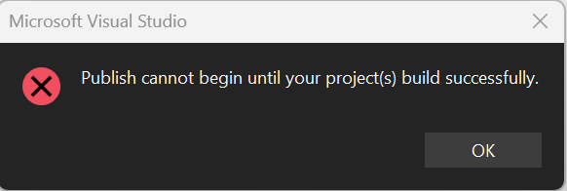
What happens in a Deployment?
VS compares the objects defined in the SQL project vs what is on the server.
Anything that is in the SQL project but not in the server is scripted as an "add" (e.g. CREATE VIEW).
Anything that is in the SQL project and the SQL server, but differs in definition (e.g. a view has a different order of columns or an extra column), gets changed. Sometimes via an alter statement and sometimes via a drop/create. The deployment engine decides that for you.
It is important to note that, by default, the deployment engine will NOT do any changes that have the possibility of losing data in the server. For example, a column being removed from a table or a column changing to a smaller type.
Removing a column from a View or Stored Proc does not constitute data loss. You might be thinking, if the view is missing the column would not that affect anything else that depends on the column? The answer is yes and there are two ways to prevent issues:
Any SQL object that refers to that column within the db, will fail to compile in the project so you would know that you are referencing something that is now missing so you would not even be able to get to the deployment step because compilation would fail.
If your external code references that missing column, then you would do the same thing you would do if you .net public API has a breaking change. We will talk more about it later when we talk of the db as a service.
Anything that is not in this SQL project but it is in the db, will NOT be touched by default.
Database settings (such as Read Committed/Snapshot)are applied by default.

Slide 14
Command line publishing
msbuild "nameofsqlproject.sqlproj" /p:Configuration=Release
dotnet tool install -g microsoft.sqlpackage
SqlPackage /Action:Publish /SourceFile:".\bin\release\nameofsqlproject.dacpac" /TargetConnectionString:"ConnectionString to the db you want to publish to” /p:ScriptDatabaseCompatibility=true
For example (PodcastsManager/src/PodcastsManager/2-Data/PodcastsManagerDb/publish-to-local-sqlexpress.bat at main · TheJuanitoLearnsShow/PodcastsManager):
msbuild "PodcastsManagerDb.sqlproj" /p:Configuration=Release
dotnet tool install -g microsoft.sqlpackage
SqlPackage /Action:Publish /SourceFile:".\bin\release\PodcastsManagerDb.dacpac" /TargetConnectionString:"Data Source=.\sqlExpress;Database=PodcastsManager;Integrated Security=True;" /p:DropObjectsNotInSource=True /p:ScriptDatabaseCompatibility=True /p:BlockOnPossibleDataLoss=False

Slide 15
Automated testing
Many ways to implement automated testing
Custom tests from .NET.
SQL-Specific Unit Test frameworks (e.g.: tUnit).
Custom, generic, convention-based automated testing using xUnit template.
Demo of Reusable xUnit project
CI/CD integration
Notes:
Alexandria is now very happy that she could setup automated deployment to the test severs via their source control provider (GitHub). David is very happy too, but then asks, where are the automated tests that run before deployment. Alexandira knew something was missing and David pointed it out. In her .net projects, she uses .net test suite projects that run automatically in the CID/CD pipelines. The tests gives her team a degree of confidence that any new changes added to the repo are not introducing any issues. The code they are writing in the SQL in this new db is complicated enough and important enough to demand at least some level of safeguards. Michael J helps her research testing approaches to SQL code. They find three approaches:
Call you sql code from .net unit test projects (e.g. xUnit)
Requires manually writing the c# code for each of the SQL functionality you want to test.
Use T-SQL specific unit test frameworks or tools, such as tUnit
Use a generic xUnit project that can be reused without much modification between projects and that does not require writing .NET for each of the SQL features to test
This is my preferred way (see sample GitHub repo)
Use a specific SQL schema for SQL objects that support the automated tests. This makes it easier for the automated tool to discover the tests and for maintainers to understand what the purpose of those objects are.
Test Stored procs can use transactions to rollback any data they manipulated during the test. This is somewhat similar to how SalesForce does its Apex unit tests (if you are familiar with SalesForce).

Slide 16
Custom generic xUnit Project
Sample in repo
https://github.com/TheJuanitoLearnsShow/PodcastsManager/tree/main/src/PodcastsManager/7-Tests/DatabaseTestRunner
Uses a convention approach to discovering test stored procedures from the SQL db
Each test stored procedure follows the arrange, act, assert pattern.
Uses transaction that are rolled back after the test
The results produced by the SP will be examined by the xUnit code to determine if the follow the PASS/FAIL convention
The C# code is minimal and easily ported to another solution

Slide 17
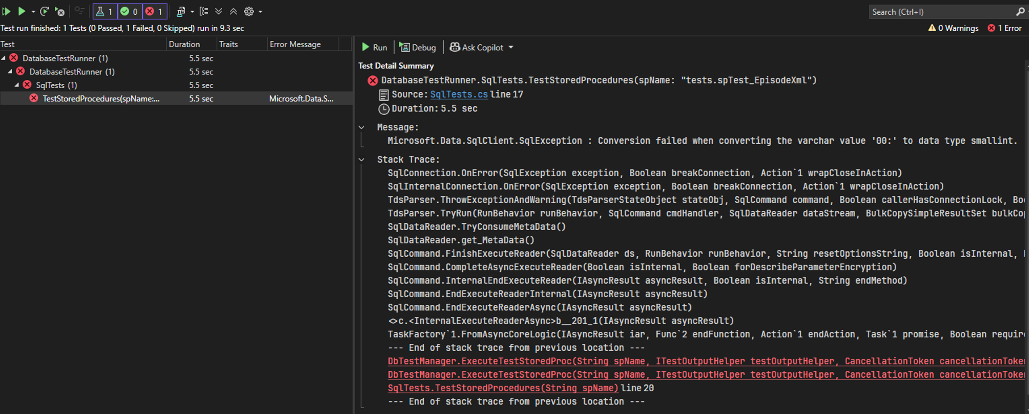

Slide 18
Additional Resources
Formatter
Poor Man's T-Sql Formatter is a VS extension that allows you to format sql code in Visual Studio. It is my preferred formatter for T-SQL
https://marketplace.visualstudio.com/items?itemName=mick9956.PoorMansTSqlFormatter
Resources
Get started with SQL database projects - SQL Server | Microsoft Learn ( https://learn.microsoft.com/en-us/sql/tools/sql-database-projects/get-started )
9 Tips for Faster SQL Server Applications - Brent Ozar Unlimited® (https://www.brentozar.com/archive/2019/05/9-tips-for-faster-sql-server-applications )
https://jptarqu.blogspot.com/2023/04/add-sql-server-database-projects-to-ci.html
SqlPackage Publish - SQL Server | Microsoft Learn (https://learn.microsoft.com/en-us/sql/tools/sqlpackage/sqlpackage-publish )

Slide 19
Additional Resources
Resources
sql-projects-devops-samples/Demos/2-ContinuousIntegration.md at main · Azure-Samples/sql-projects-devops-samples · GitHub (CI/CD with containers)
.net conf 2024 talk: Next-gen SQL projects with Microsoft.Build.Sql

Slide 20
SQL Projects for the Win!!!
Declarative way to define your databases.
Source control friendly.
Automated deployments
Automated tests
Model your databases as close to the business problem as possible
Your database is a service not just a repository of CRUD tables.

Slide 21
Questions, Questions, Questions???
Best part of sessions like this one ☺

Slide 22
Thank you! Win something at the raffle!

